Slide 1

NEW YEAR'S RESOLUTIONS
By Free Kids Books

Slide 2
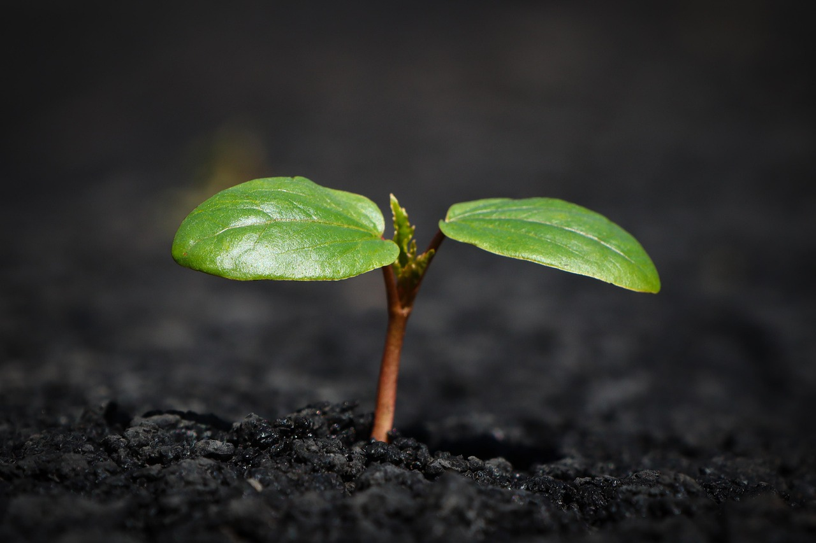
My New Year Goals
This book helps you plan, track, and celebrate your goals this year.
Setting goals helps you grow and learn!
How to use this book: Print and fill out the spaces on each page, use more paper if you need, or reprint the page OR Use one of the editable files to type in your answers (formatting may change with different computers).

Slide 3
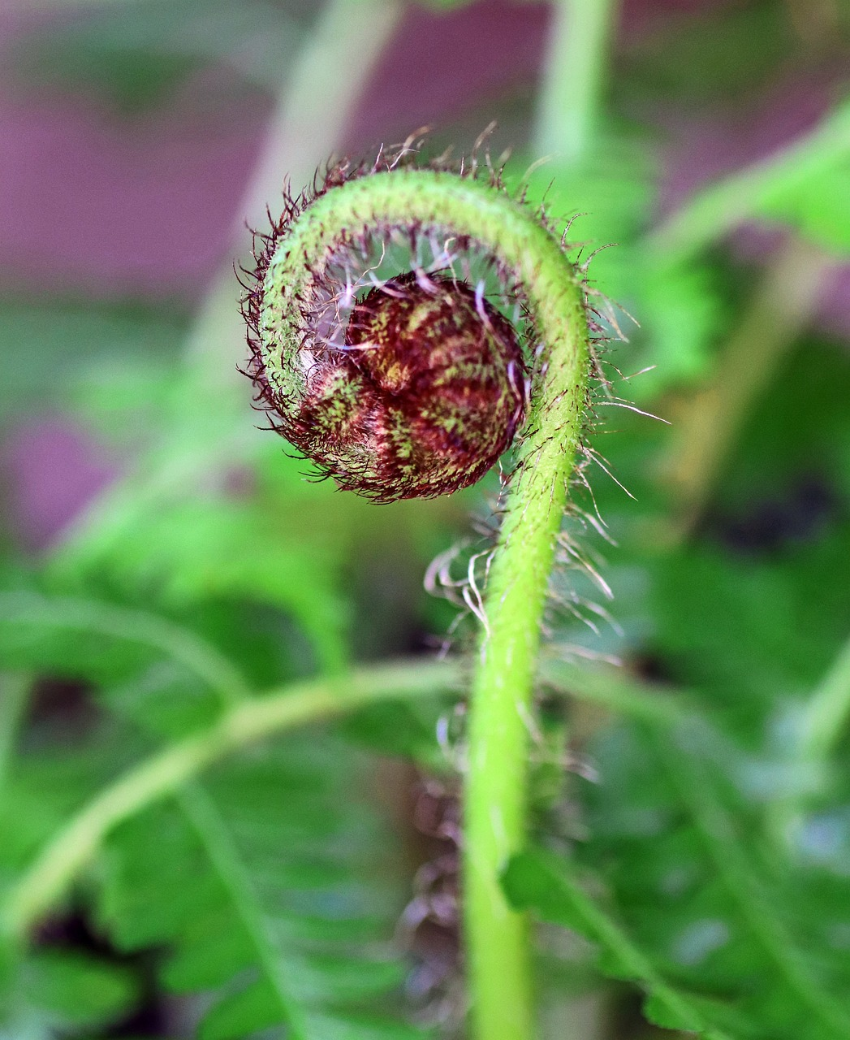
What Is a Resolution?
A resolution is a goal you choose to work on over time.
Resolutions can help us grow as individuals or contribute to the community.

Slide 4

Choose Your Top 3 Goals for this Year
1. __________________________________________________
____________________________________________________
2. __________________________________________________
____________________________________________________
3. __________________________________________________
____________________________________________________

Slide 5

Personal Growth
How will you challenge yourself this year?
1._____________________________________________________________________________2._____________________________________________________________________________3._____________________________________________________________________________4._____________________________________________________________________________

Slide 6

Health & Wellbeing
What habits will you develop to help your body and mind?
1.________________________________________________________2.________________________________________________________3.________________________________________________________4.________________________________________________________

Slide 7

Learning Goals
What new skills or subjects excite you?
1. _____________________________________
2. _____________________________________
3. _____________________________________
4. _____________________________________

Slide 8
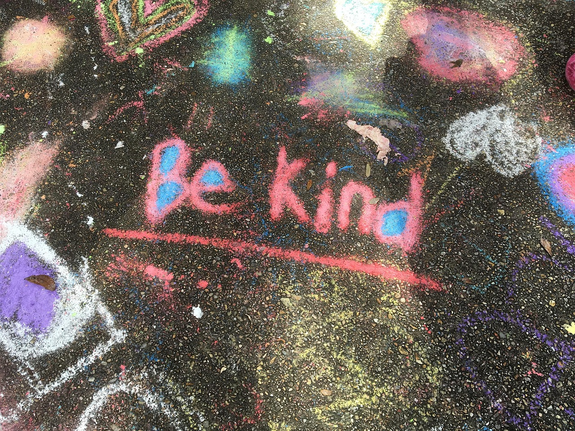
Helping Others
How can you make a positive difference?
1. _____________________________________
2. _____________________________________
3. _____________________________________
4. _____________________________________
3. _____________________________________
IN A WORLD WHERE
YOU CAN BE ANYTHING:

Slide 9

Monthly Goal Tracker
Goals: ☐ Tried my best ☐ Stayed true ☐ Practiced my goal
Personal Growth: ☐ Tried my best ☐ Stayed true ☐ Practiced my goal
Mind and Body: ☐ Tried my best ☐ Stayed true ☐ Practiced my goal
Learning: ☐ Tried my best ☐ Stayed true ☐ Practiced my goal
Being Kind: ☐ Tried my best ☐ Stayed true ☐ Practiced my goal
Note: Print this page for each month

Slide 10



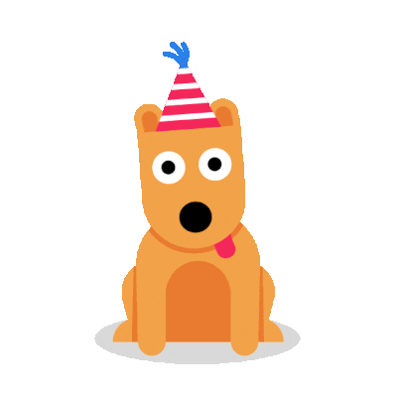



Weekly Rewards
Note: Print this page when you need it.
Reward yourself with a sticker:
⭐ 🌟 🐠 🐢

Slide 11
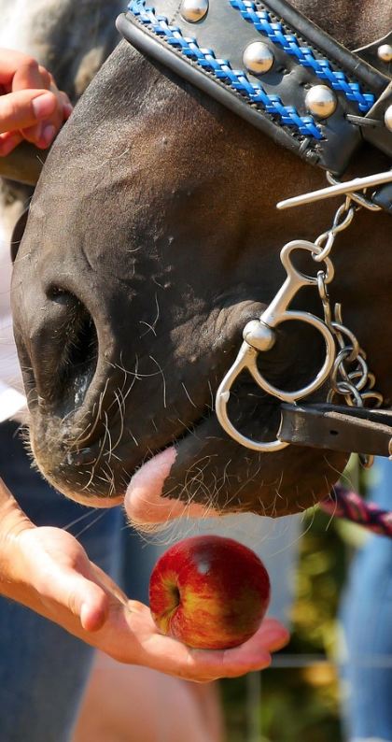
Rewards Page
When I reach a goal, I reward myself with:
1. _______________________
2. _______________________
3. _______________________
4. _______________________
5. _______________________

Slide 12

Reflection
What are you proud of so far?
1. _____________________________________
2. _____________________________________
3. _____________________________________
4. _____________________
_______________________
5. _____________________
_______________________

Slide 13

Congratulations - You Did It!
Now keep going! Progress matters more than perfection. Keep working towards your goals and adjust them as you need to. Pat your self on the back for what is done and don't beat yourself up for what is not. Just being there and trying your best is key.

Slide 14

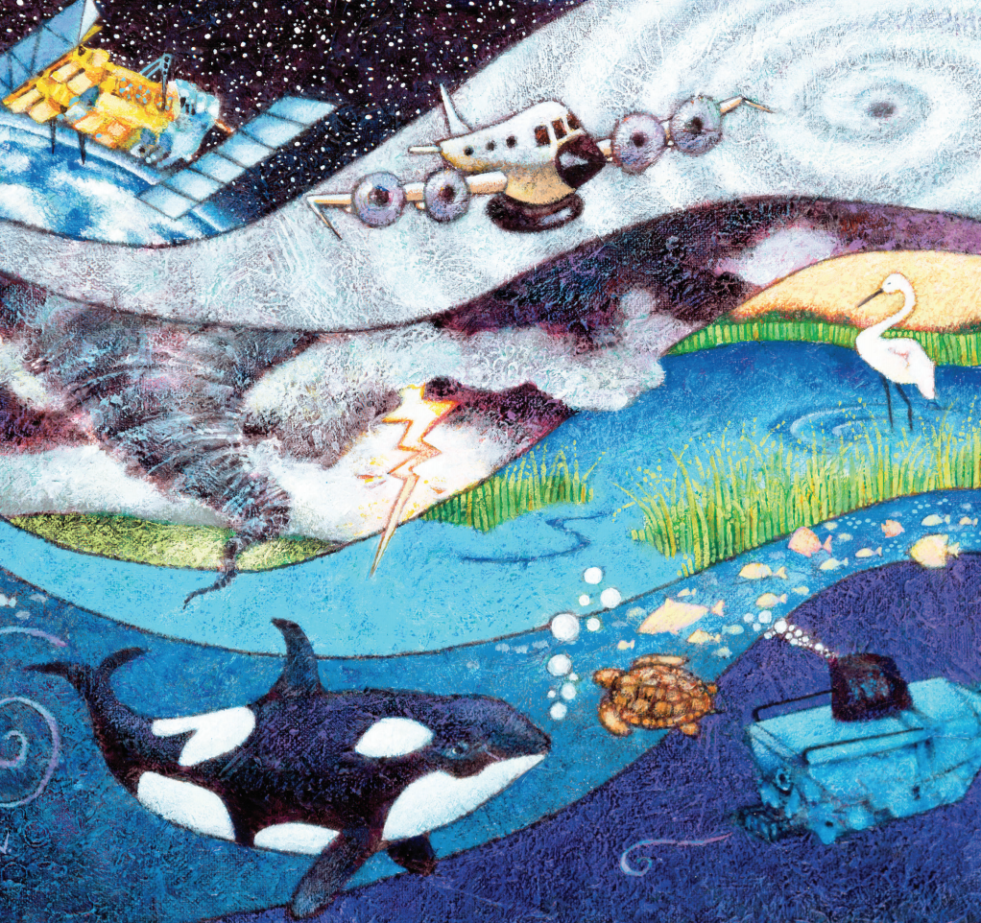
This book is shared online by Free Kids Books at https://www.freekidsbooks.org
in terms of the creative commons license provided by the publisher or author.
Want to find more books like this?
Let's read some more
https://www.freekidsbooks.org
Simply great free books -
Preschool, early grades, picture books, learning to read,
early chapter books, middle grade, young adult,
Pratham, Book Dash, Mustardseed,
Open Equal Free, and many more!
Always Free – Always will be!
Legal Note/Copyright:
This book is in PUBLIC DOMAIN -YAY!!!
That means you can reuse it in pretty much any way
you wish. We greatly appreciate if you credit to us as
a source by including a link to our site,
https://www.freekidsbooks.org,
on your post or end product, or simply leave
this page in tact, so more people can enjoy
great free books, but it is not mandatory.
Please reach out and contact us:
https://www.freekidsbooks.org/about
if you want more information, advice,you want to
share your project with us, so we can help with
promotion, or you want to help in any way.
Please, enjoy this, and our many more free kids books!
This page is added for identification and copyright
– we request that you do not remove it if you
utilise the content.
Yay!

